Slide 1

TITLE:
SHOPPING LIST APPLICATION – BACKEND
SUBTITLE:
SPRING BOOT REST API WITH DOCKER & RENDER DEPLOYMENT
III-BCA
23SUCA50

Slide 2
Backend:
The project follows modern DevOps practices, including:
Frontend and backend separation
REST API communication
Dockerization
CI/CD using GitHub Actions
Code quality analysis using Sonar
Cloud deployment using Vercel (frontend) and Render (backend)

Slide 3
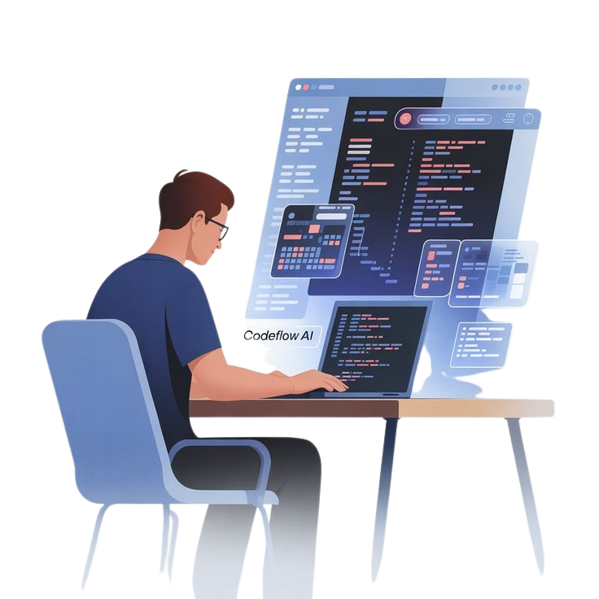
How the Project Works (Flow):
Backend (Spring Boot)
Exposes REST APIs (/api/items)
Stores shopping tems in H2 in-memory database
Handles CRUD operations (Create, Read, Update, Delete)

Slide 4
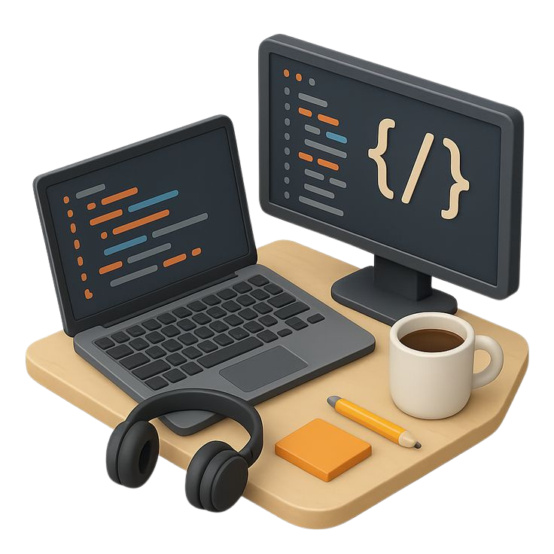
Backend Description (Spring Boot)
Built using Spring Boot
RESTful API design
Uses Spring Data JPA
H2 in-memory database
Dockerized for cloud deployment
Backend Features
POST /api/items → Add item
GET /api/items → Get all items
PUT /api/items/{id} → Update item
DELETE /api/items/{id} → Delete item
DELETE /api/items → Delete all items

Slide 5
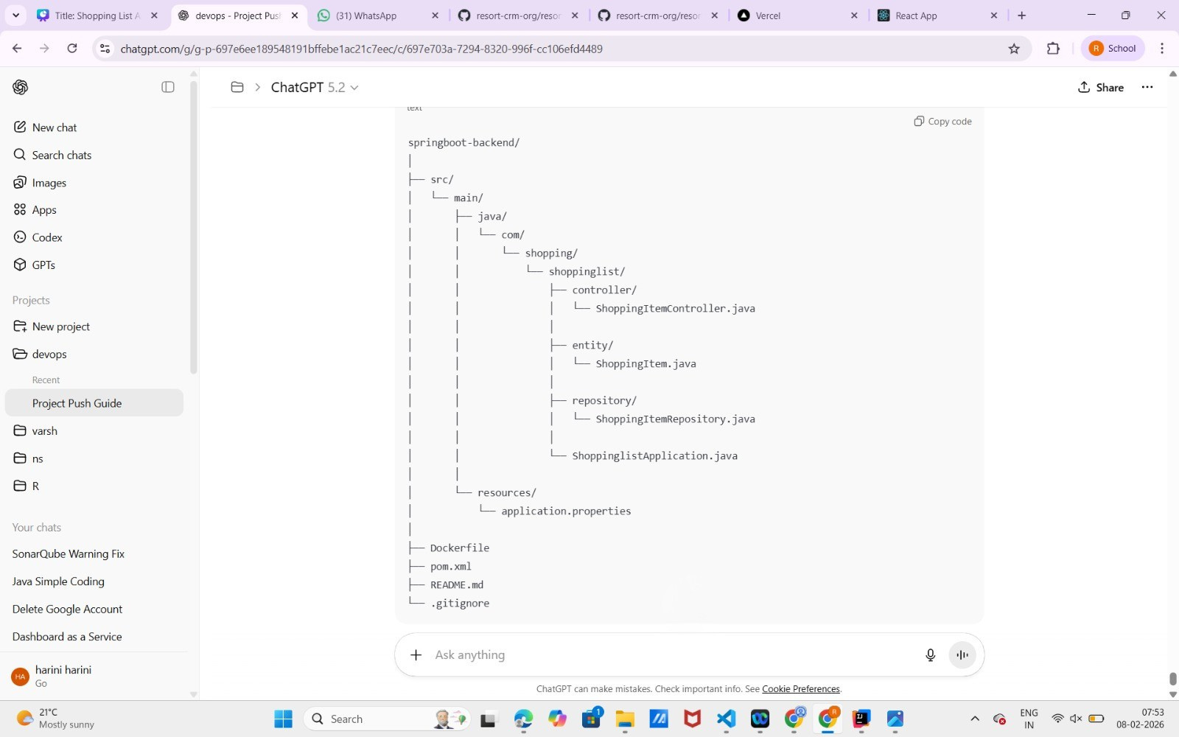
FOLDER STRUCTUTRE:
The backend of the Shopping List Application is developed using Spring Boot. It exposes REST APIs to perform CRUD operations and manages application data.

Slide 6
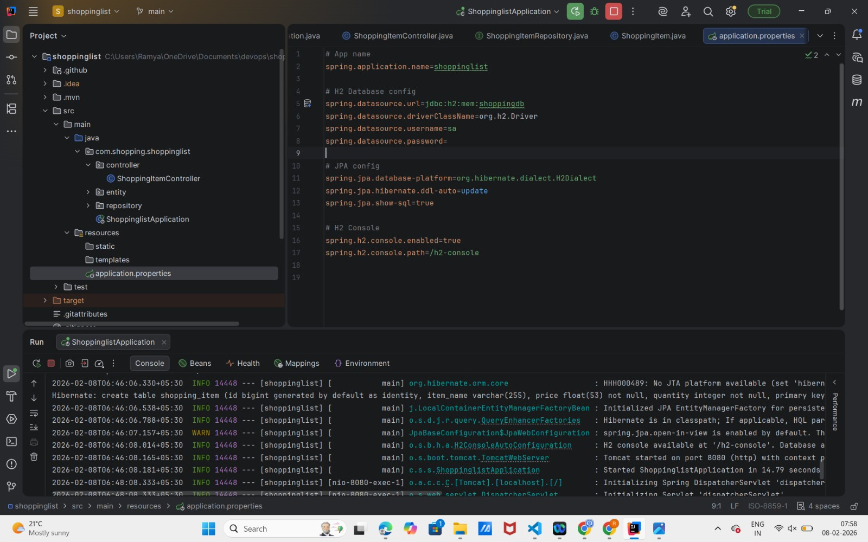
Database Configuration:
An H2 in-memory database is used for data persistence. JPA automatically manages table creation and updates.

Slide 7
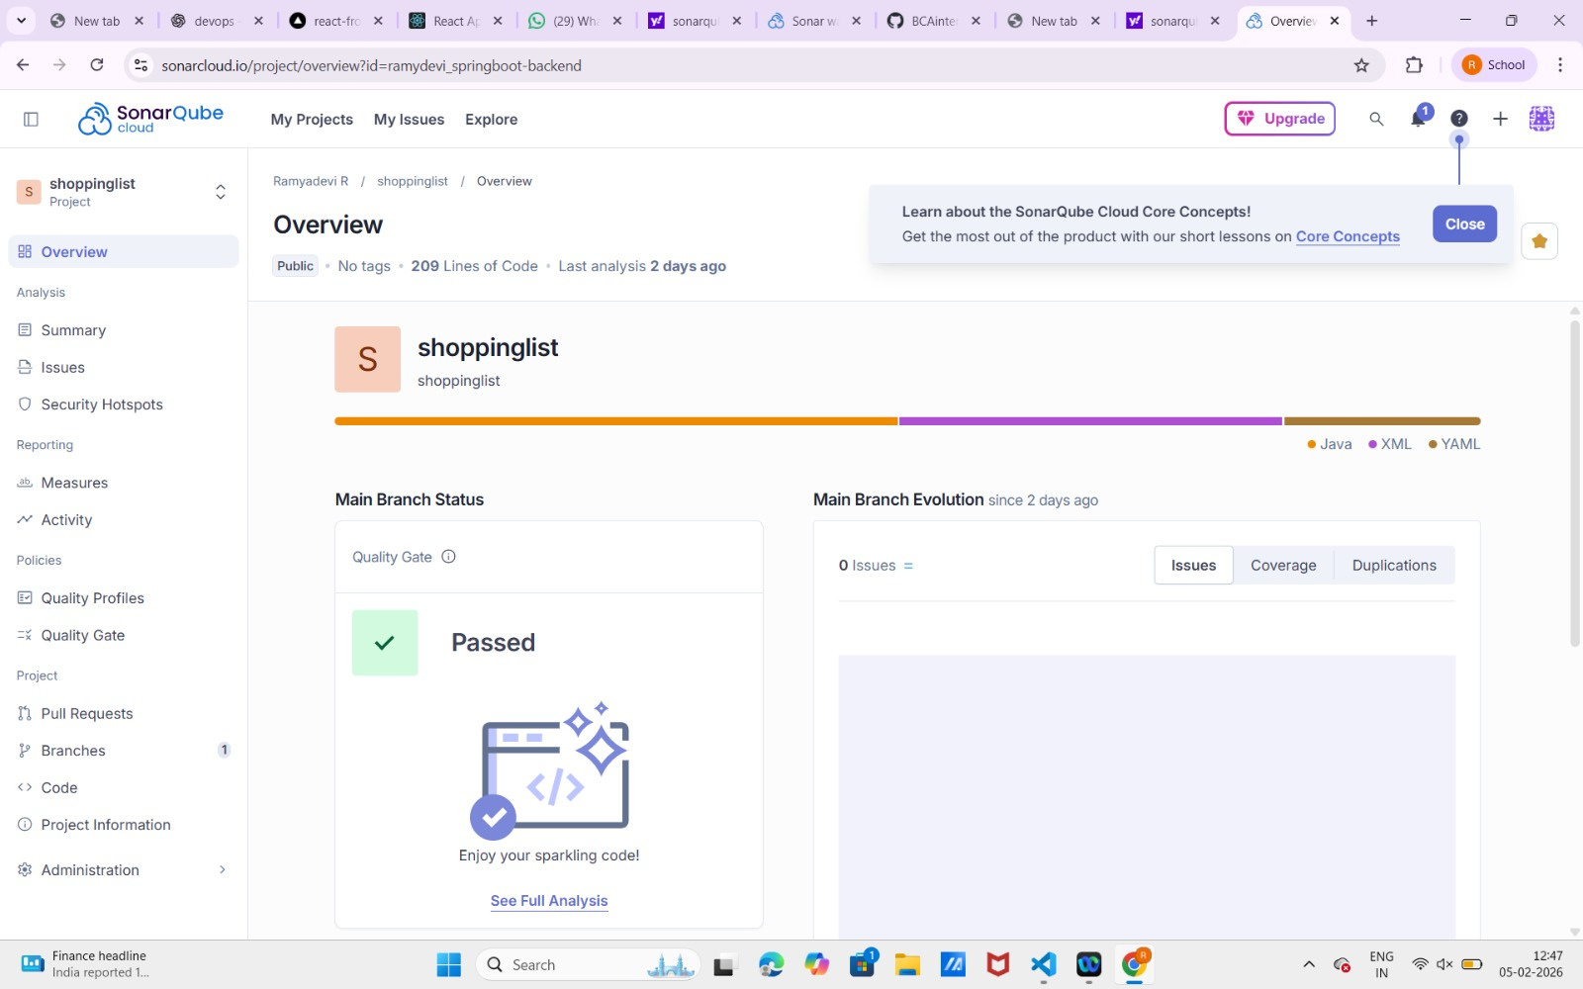
Sonar Analysis – Backend:
SonarQube analysis was performed on backend code to measure code quality, reliability, and maintainability.

Slide 8
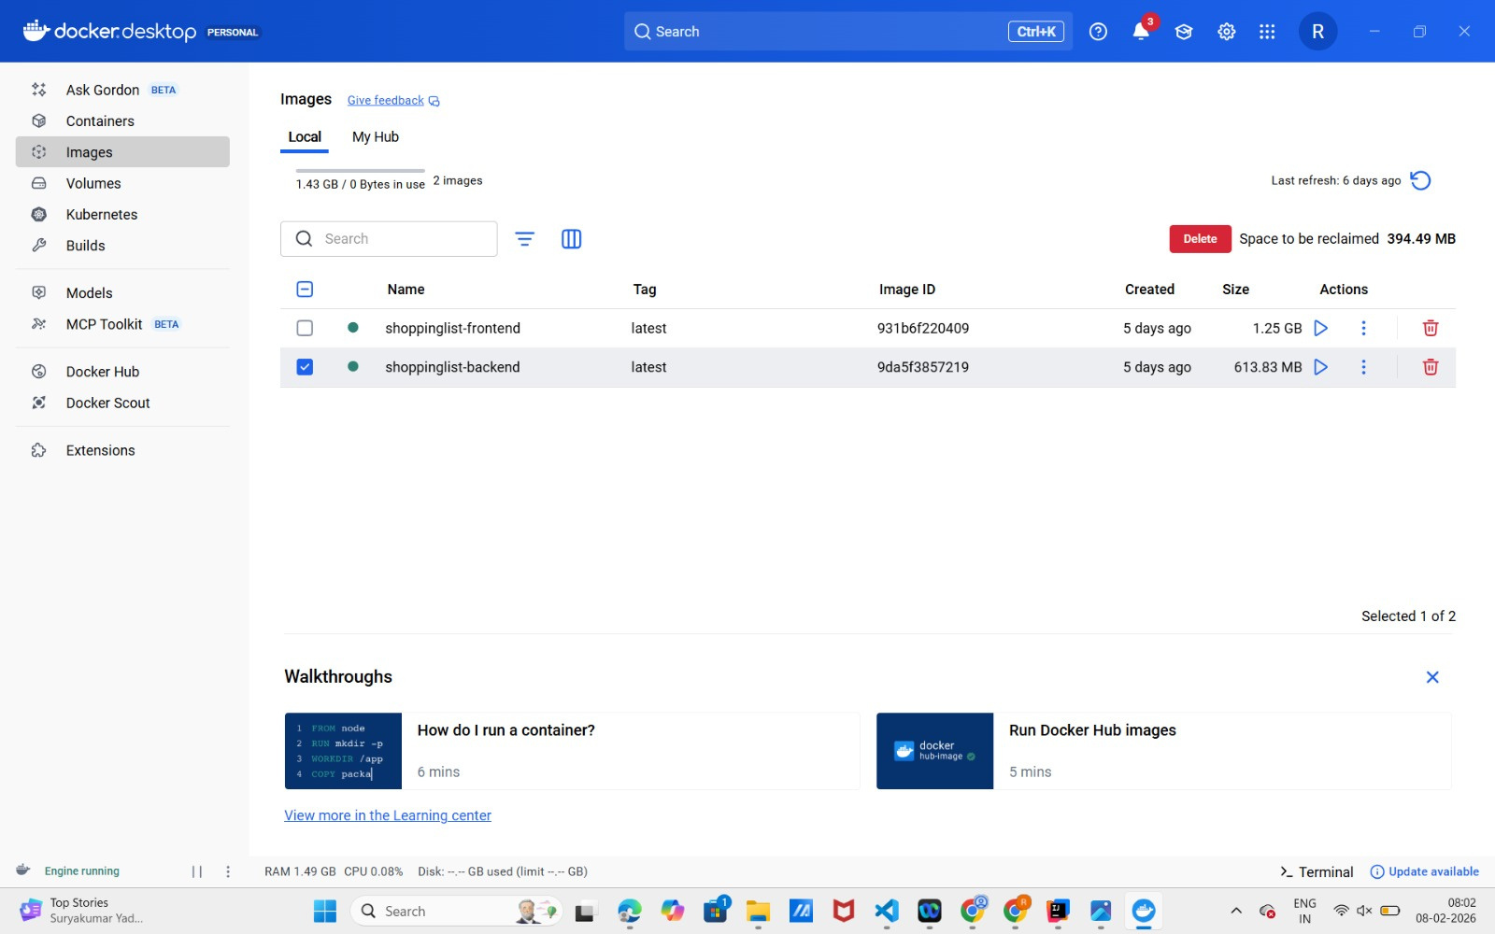
Docker Image Build:
The backend application was containerized using Docker. A Dockerfile was used to package the application into an image.

Slide 9
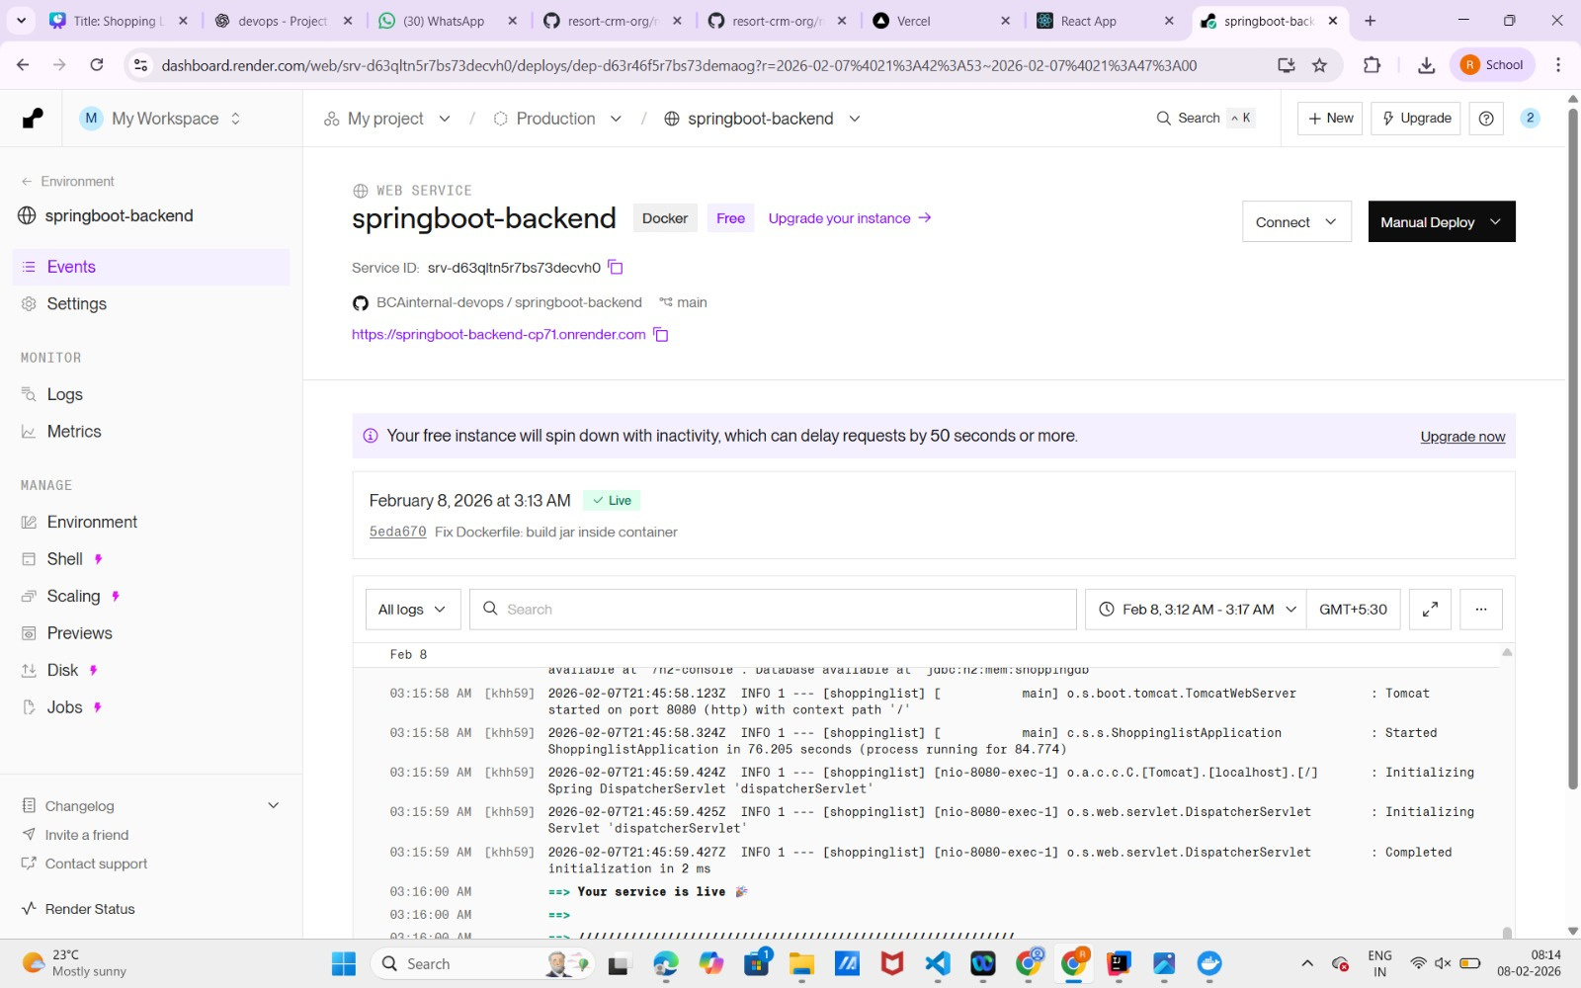
Backend Deployment – Render:
The Dockerized backend was deployed on Render as a Web Service.

Slide 10
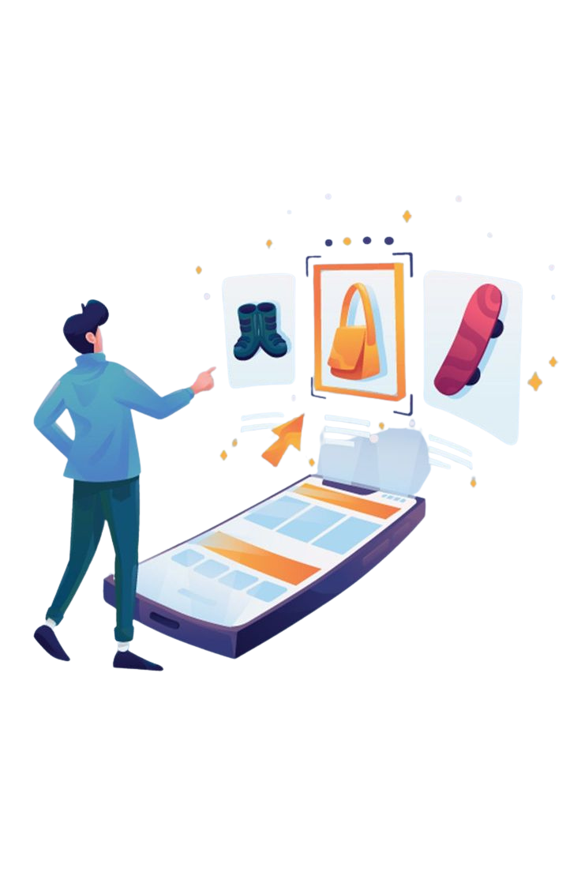
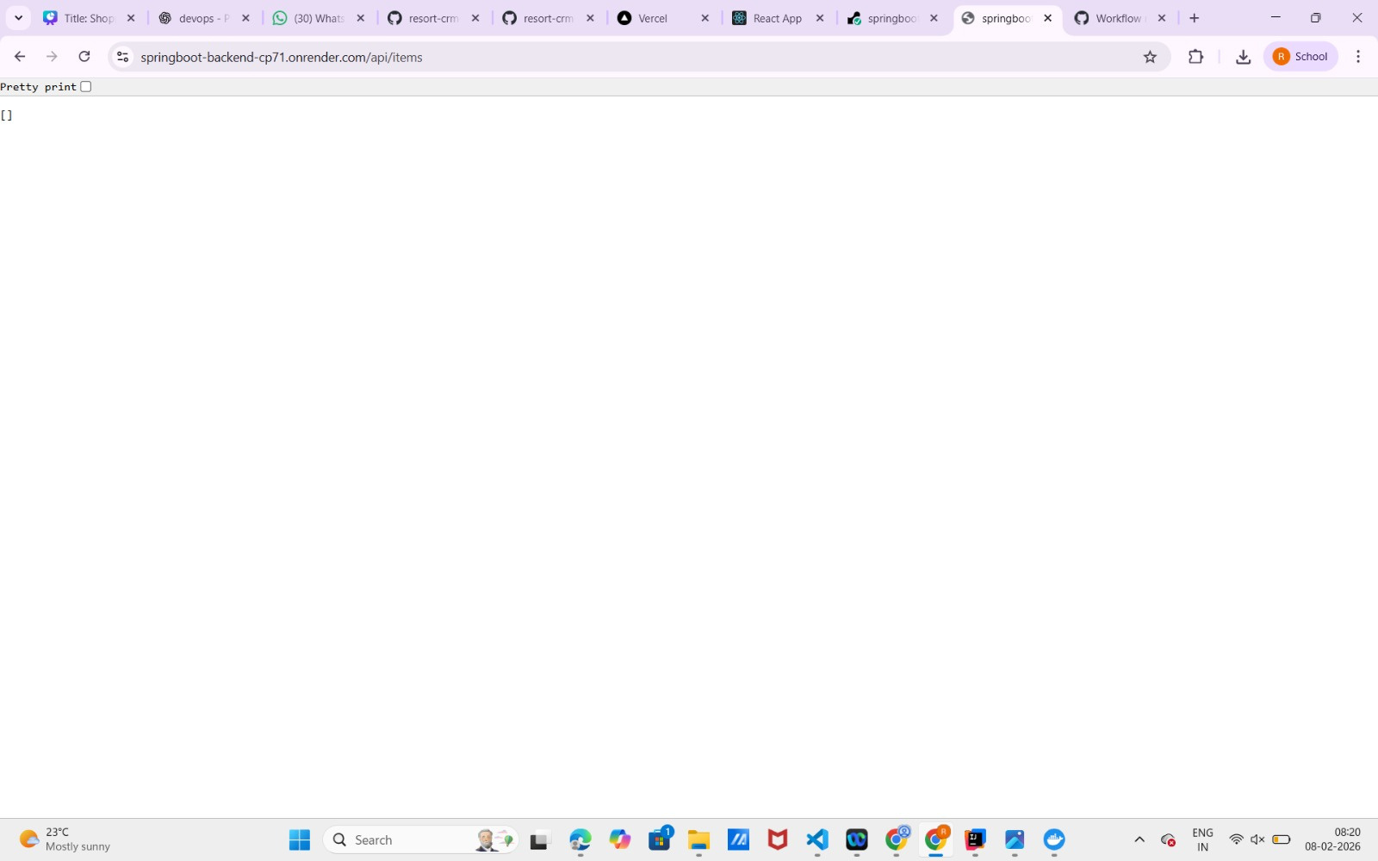
Backend API Output:
Backend APIs were tested using browser/Postman and returned JSON responses.

Slide 11
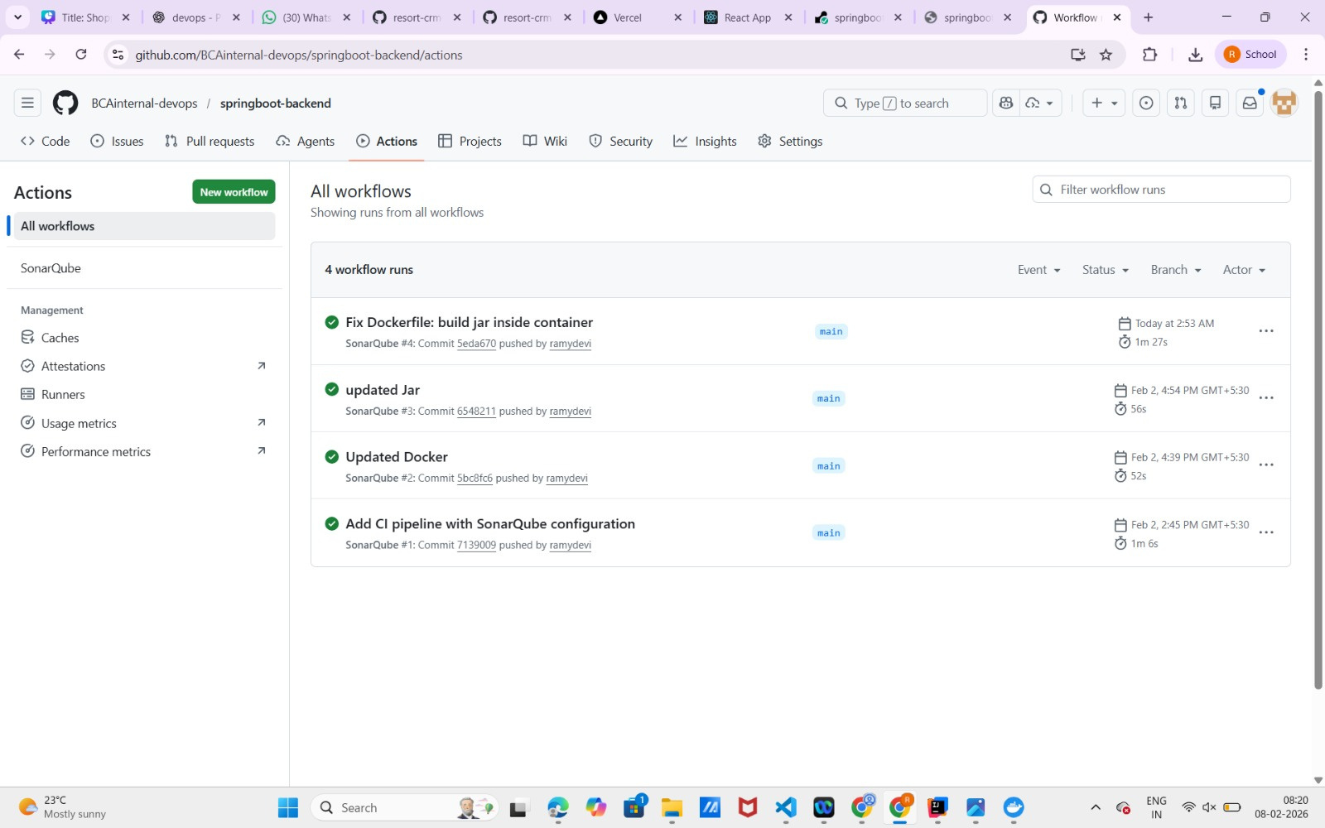
CI & GitHub Integration:
GitHub Actions was used to automate backend builds and Sonar analysis.

Slide 12

Challenges Faced:
Docker build failures
Missing JAR during deployment
Render redeploy issues
CORS configuration

